Slide 1
Anmei [Moodboard 11]

Slide 2
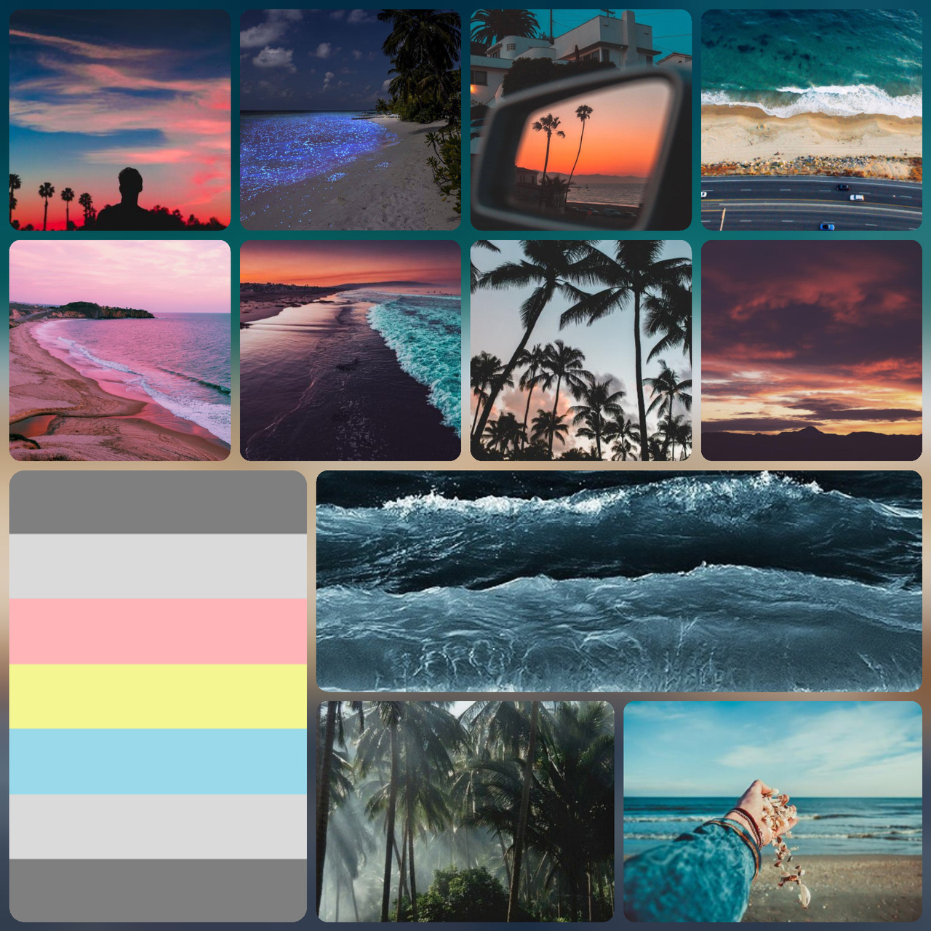
Research board

Slide 3
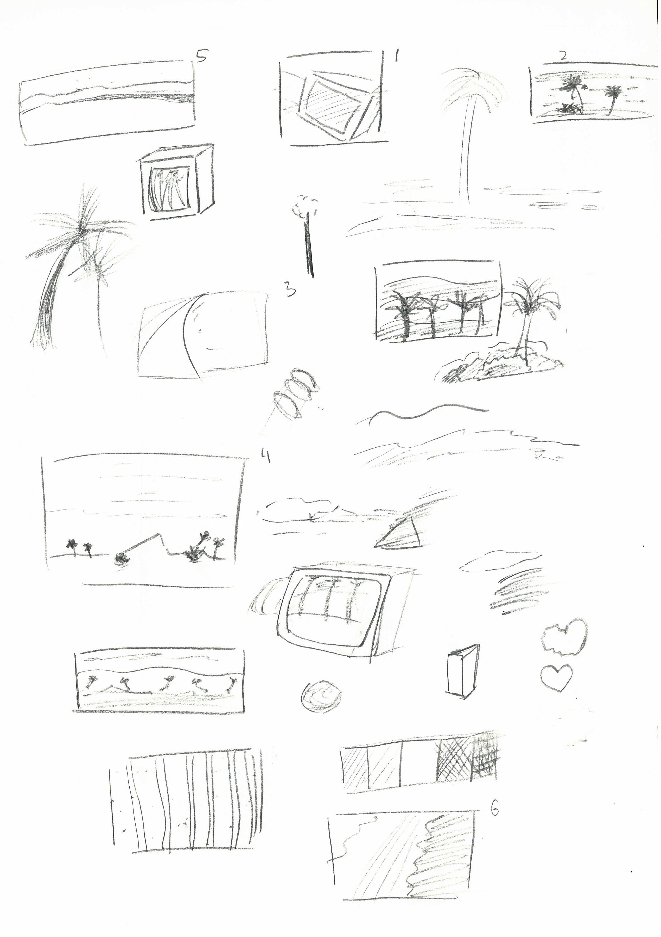
Distillation

Slide 4
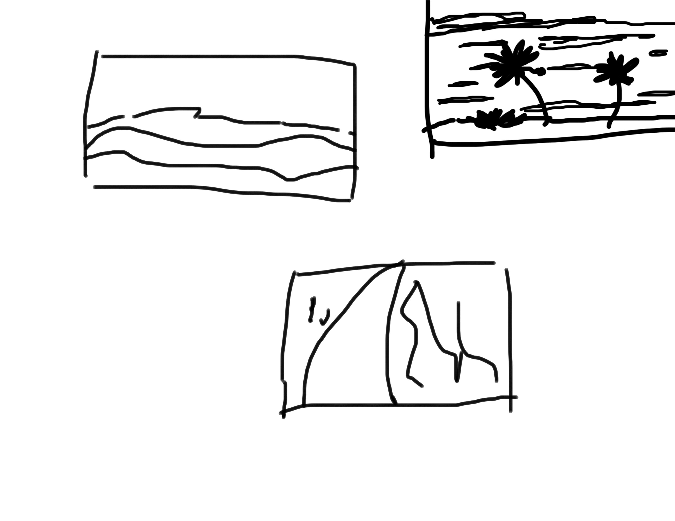
Thumbnails

Slide 5


Final art

Slide 6
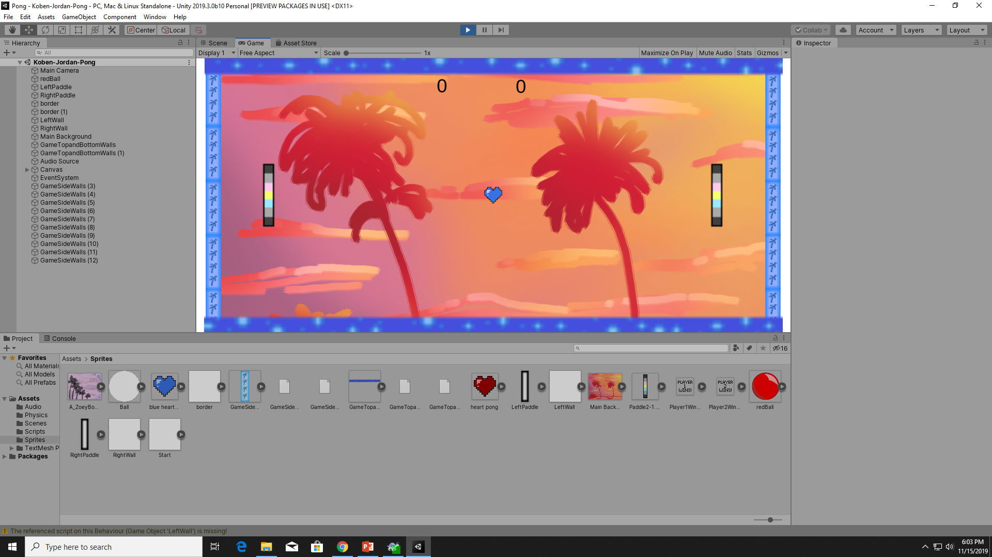
Screenshot of the game

